Slide 1

HVEC Implementation
Kyle Swartz Chandi Gastali
Vicente Alsidez-Longoria Melvin Padolina

Slide 2
Project charter and SCOPE
Objective: Develop and implement a data analytics dashboard to provide functional analysis. Project scope: High voltage’s development team will create and implement a data analytics dashboard that provides field measurements, weather forecasting, predicative analytics, security and access control along with revenue and production cost. Stakeholders: Data analytics team, IT development team, Marketing teams and engineers. Implementation: Start date: 01/11/2024 Duration: 10 months

Slide 3
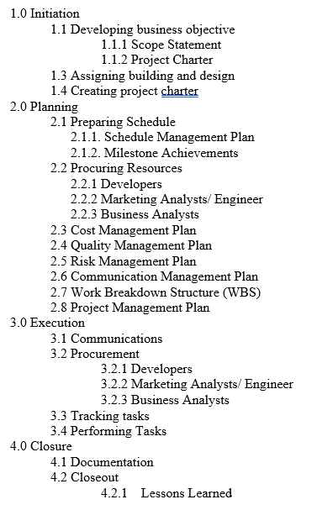
Work breakdown structure

Slide 4
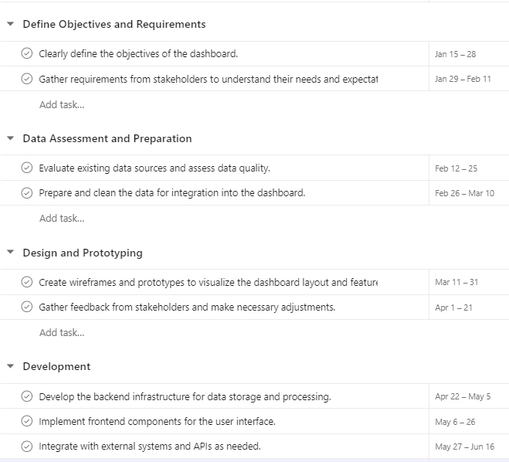
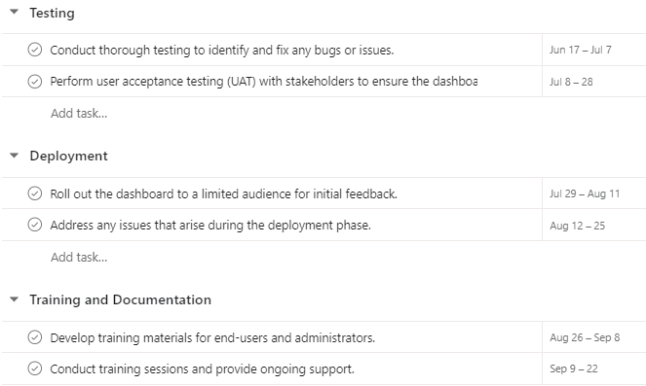
Schedule Management plan

Slide 5
10-month milestones
Completed Beta and UAT
Completed training to marketing and engineering teams
Completed Dashboard Objective
Defined Dashboard Objs./ Completed BRD
2024
Mar
Jan
Feb
Apr
May
Jun
Jul
Aug
Sep
Oct
Identified and cleaned dashboard data
Completed Front and Back End of Dashboard
Deployed Dashboard to Marketing and Engineering Team

Slide 6
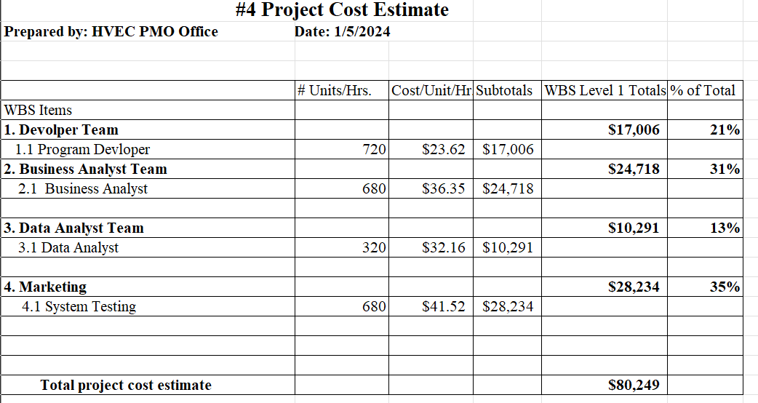
Cost management plan

Slide 7
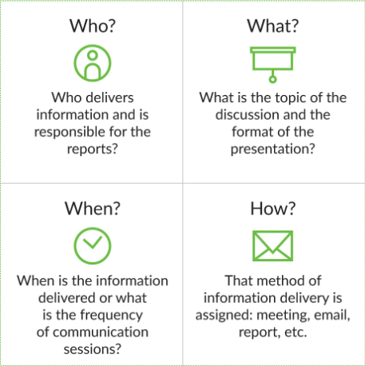
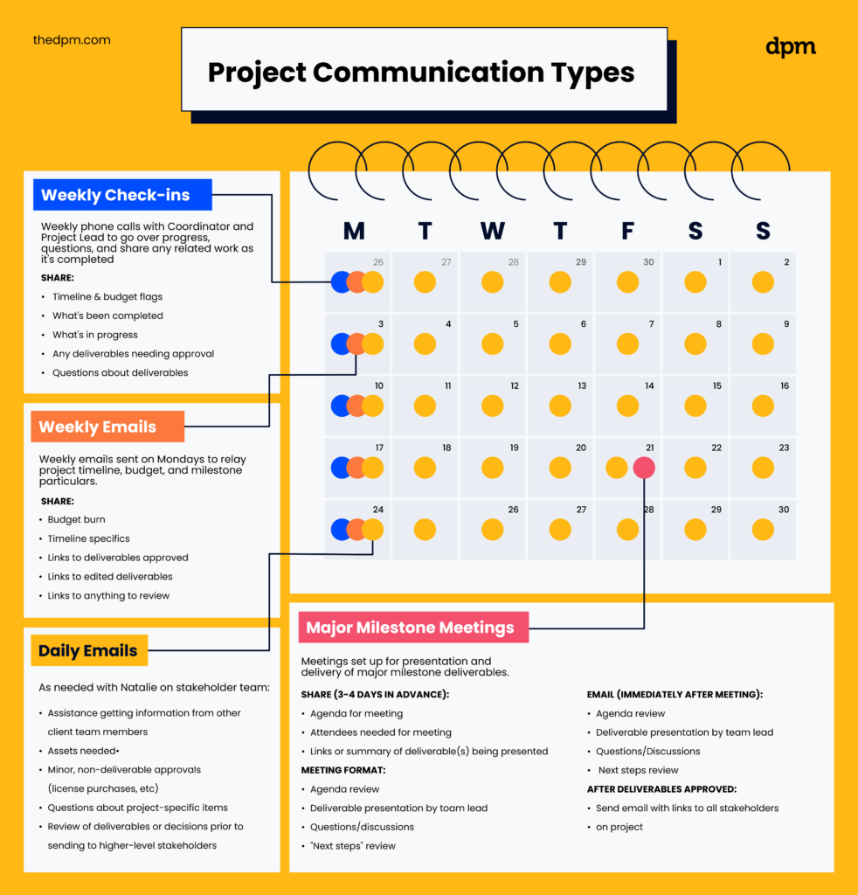
Communication management plan

Slide 8
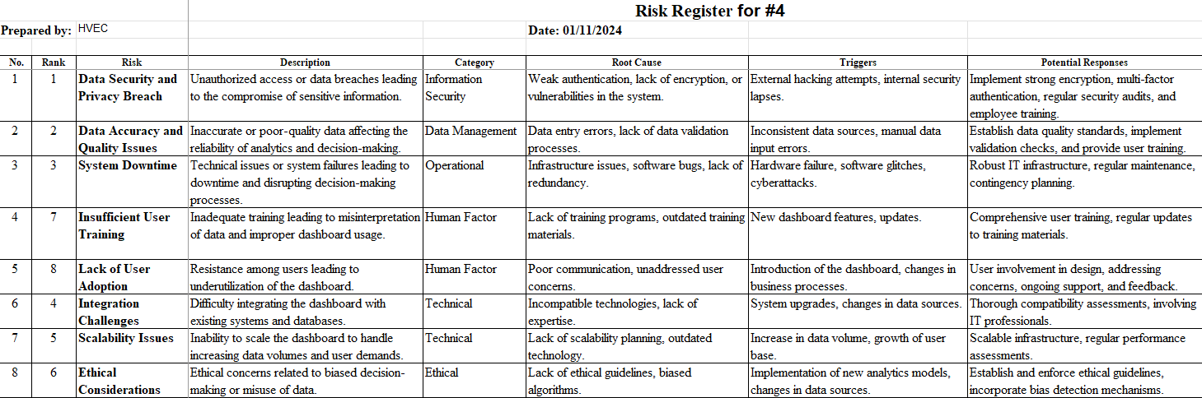
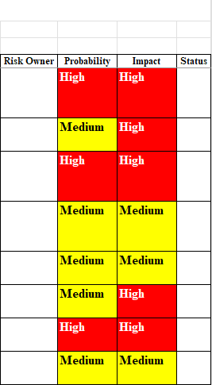
Risk management plan

Slide 9

Closing -ongoing training and updates -available support in future

Slide 10
Questions? Thank you

